Slide 1

Welcome

Slide 2


Software Engineering Re-skilling Program
Project Name : Employee Termination BOT
Divit Lal, Shekhar Kumar Tripathi, Divya Kathnaur
Created By :
NatWest Mentors:
Shitij Bhatnagar
Ajeet Verma
Ramneek Singh Chauhan
Stack route Mentor :
Annu Sharma

Slide 3
Problem Statement
To design a BOT like application, to remove or transfer employee details from various HR systems post last working day of employee once the resignation is accepted in the system. The bot should start making necessary changes in relevant HR systems preparing flags to take effect post last working day of the employee eliminating dependency on HR agents to do this manually

Slide 4
Purpose
The primary purpose is to automate the labor-intensive and manual process of handling employee data post-resignation. This includes tasks such as removing access, updating records, and preparing for the employee's departure.
The BOT aims to increase the efficiency of HR operations by reducing the dependency on HR agents to perform these tasks manually. By automating the process, it is expected to save time.
By eliminating the need for HR agents to handle these tasks manually, the purpose is to enhance the user experience for both HR personnel and departing employees, making the process more efficient and less prone to errors.

Slide 5

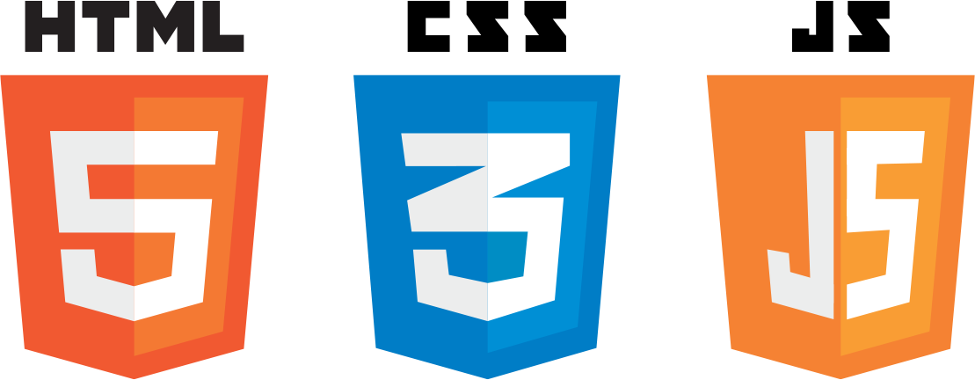




TechStack

Slide 6
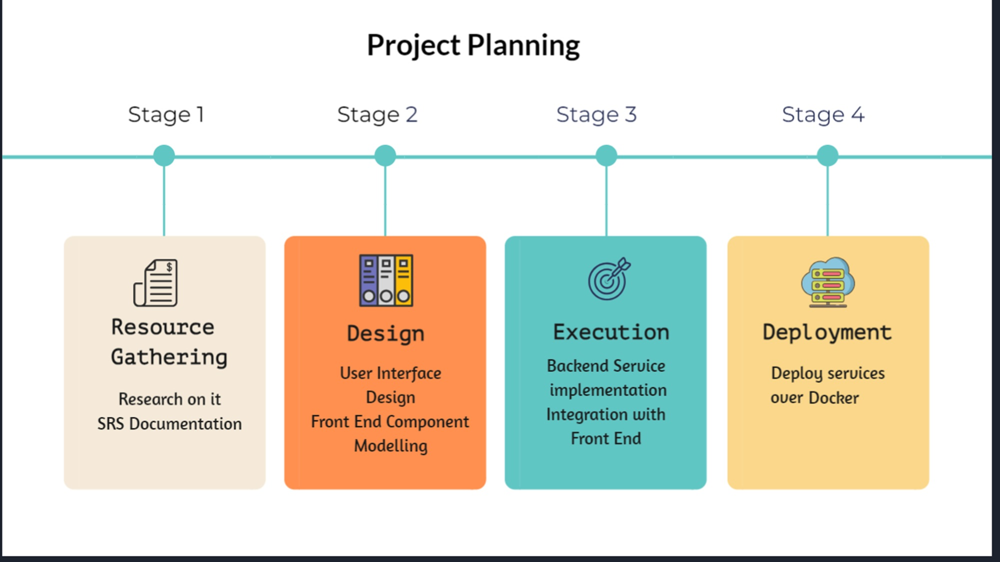
ARCHITECTURE

Slide 7
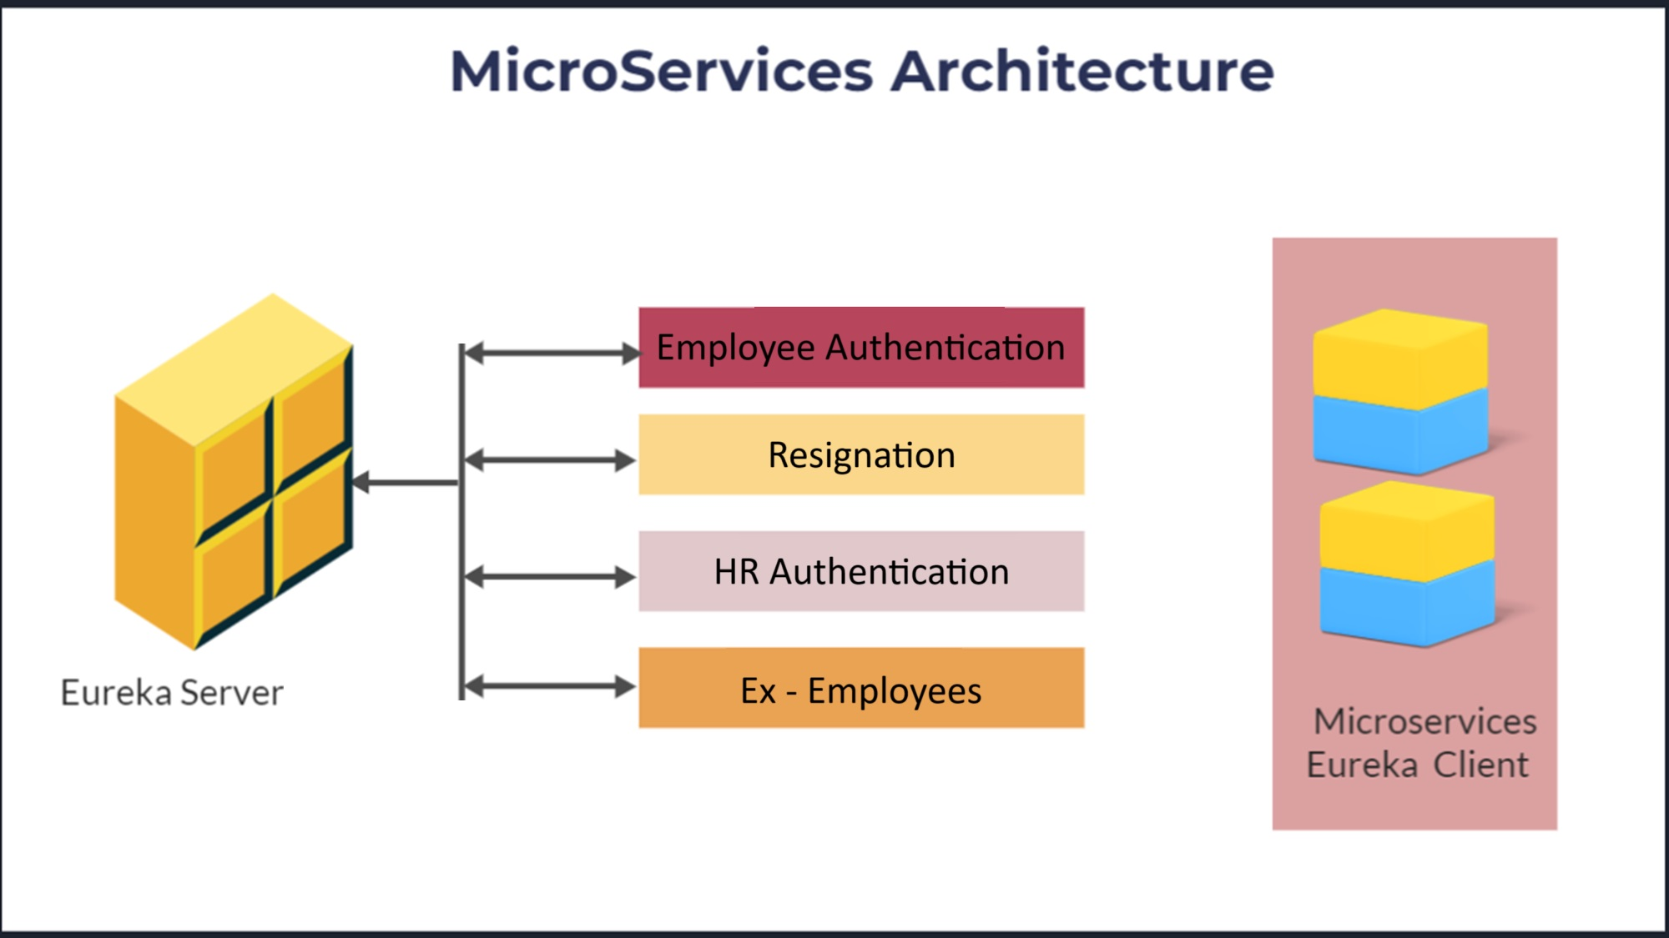

Slide 8
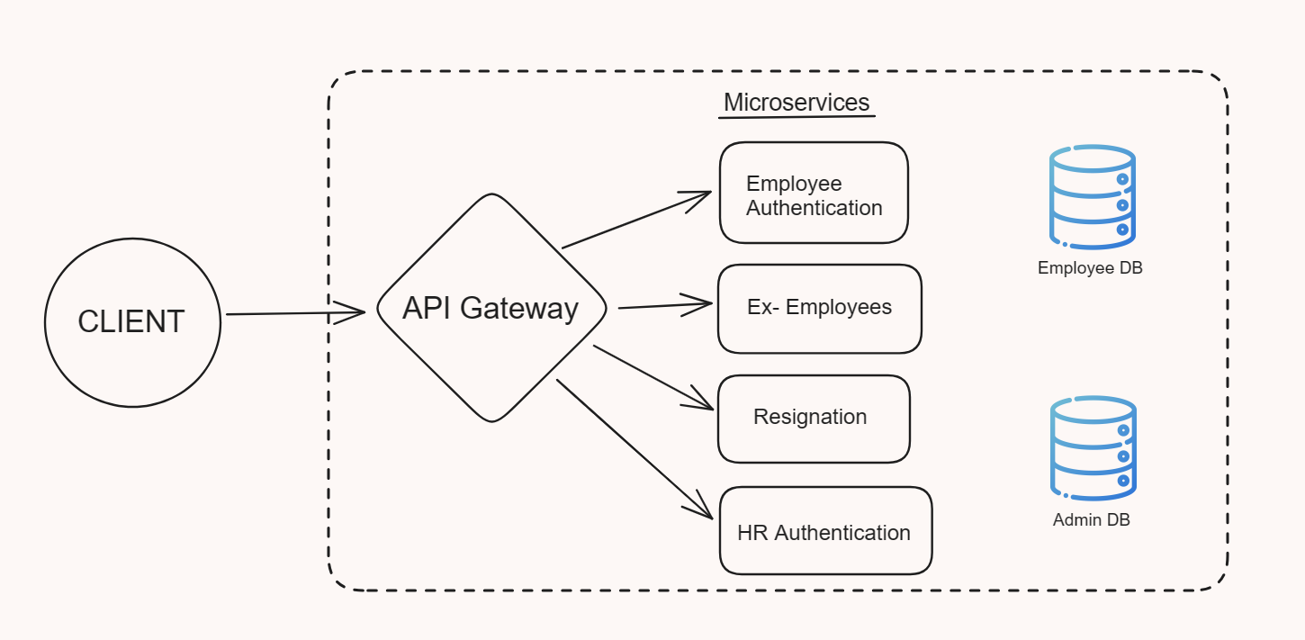
ARCHITECTURE

Slide 9
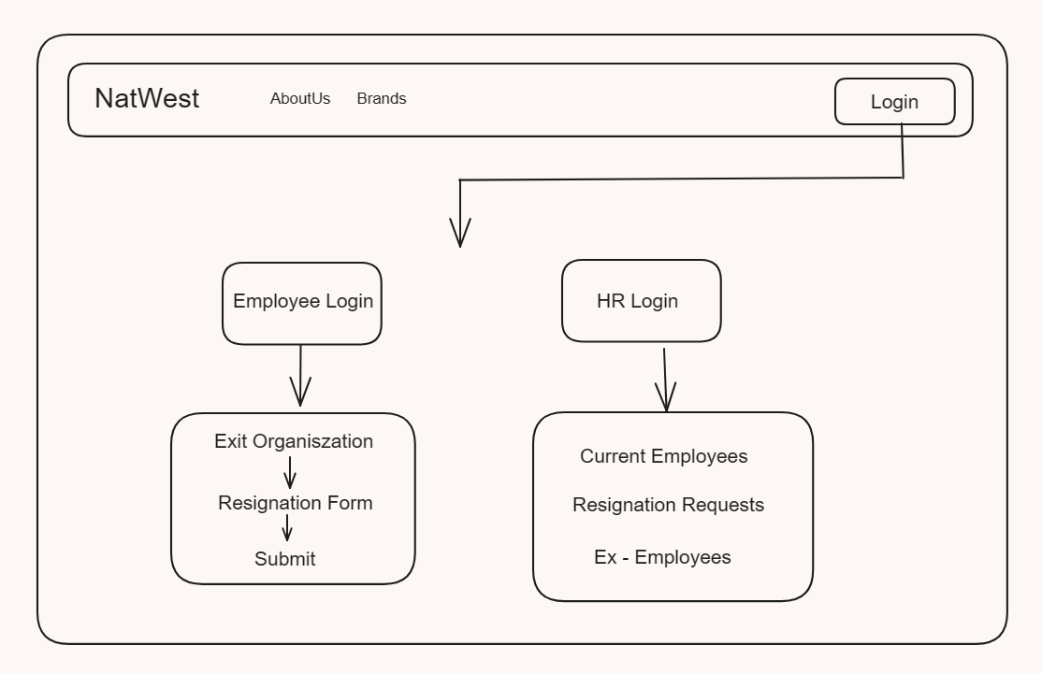
UI Representation

Slide 10
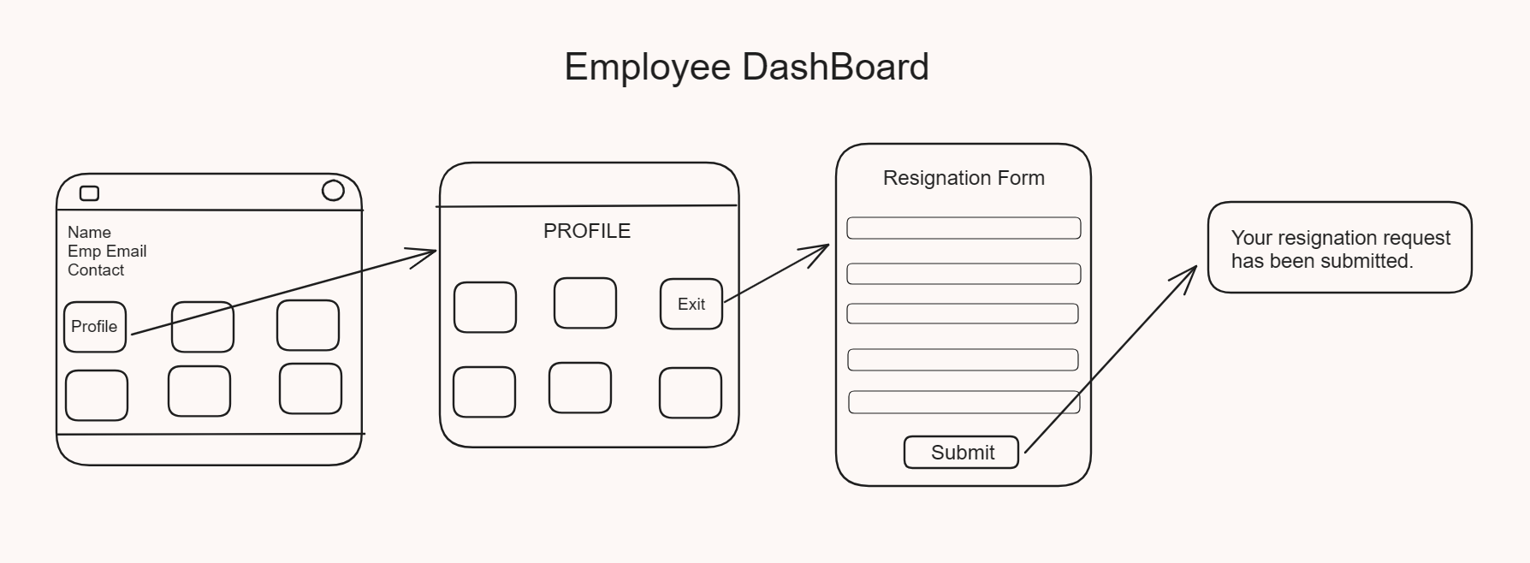

Slide 11
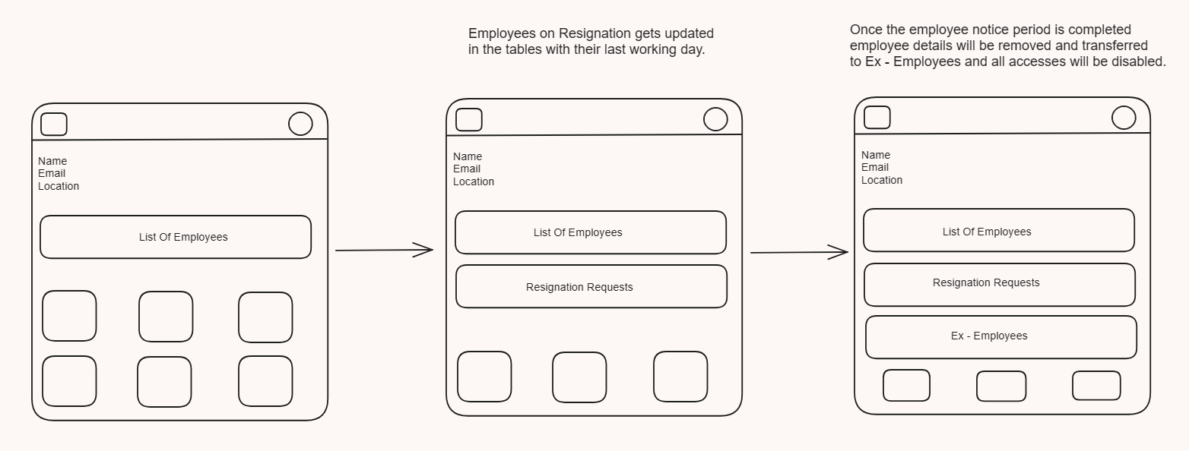
HR DashBoard

Slide 12
Future Scope
Some additional services created in the UI which were not part of the project ,are under development and these will also be added soon
We will also work on the scope of implementing flags and removing the various HR accesses.
Feedback and suggestions will be looked upon

Slide 13



